Slide 1
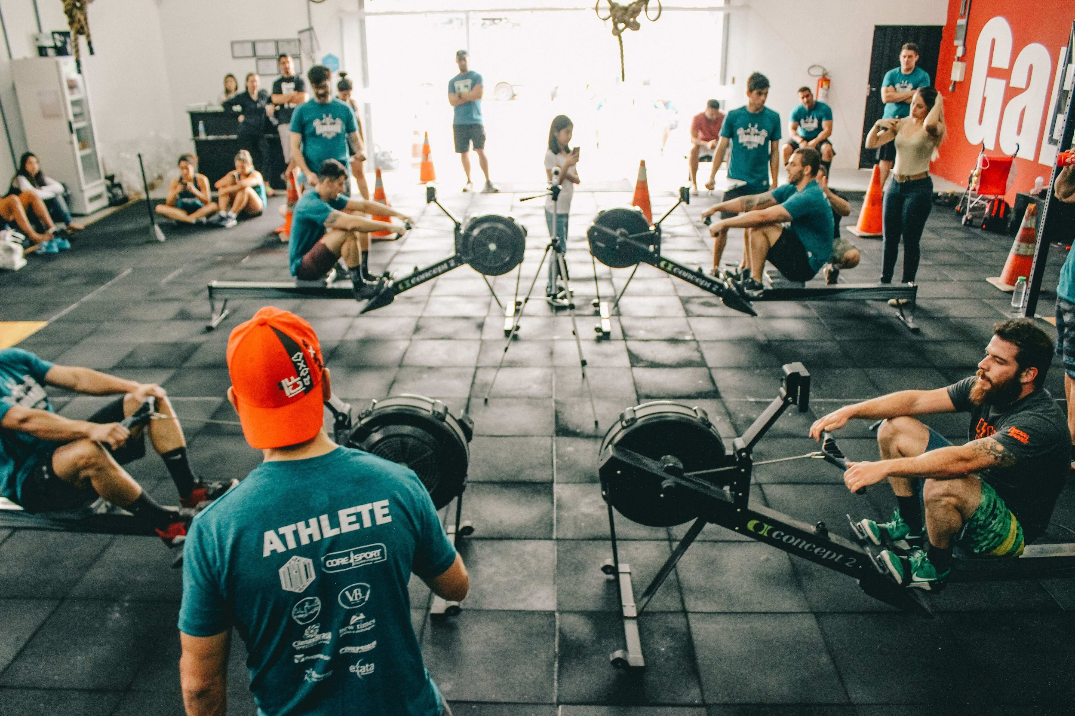
FIT MANAGE: Revolutionizing Fitness Center Management
Group 11 Pavan Gopalkrishna Pai 002833362
Christina Albert Daniel 002833358
Shruti Dhamdhere 002812094
Jaswanth Joe 002813226
Pranav Ravindra Sonje 002833018

Slide 2
Problem Statement and Goals
Gym, a personalized fitness center, faces limitations and opportunities for improvement. We aim to identify and address these issues.
Goals:
Objective Clarity: Define Gym's primary objective of promoting healthcare and physical fitness.
Seamless Operations: Ensure smooth overall functioning through an extensive database.Created a user- friendly application for easy sign-up, subscription management, and schedule checks.
Diverse Fitness Routines: Offer diverse exercise options in subscription packs for member flexibility.
Merchandise Integration: Enable purchase of gym merchandise for an enhanced member experience.

Slide 3
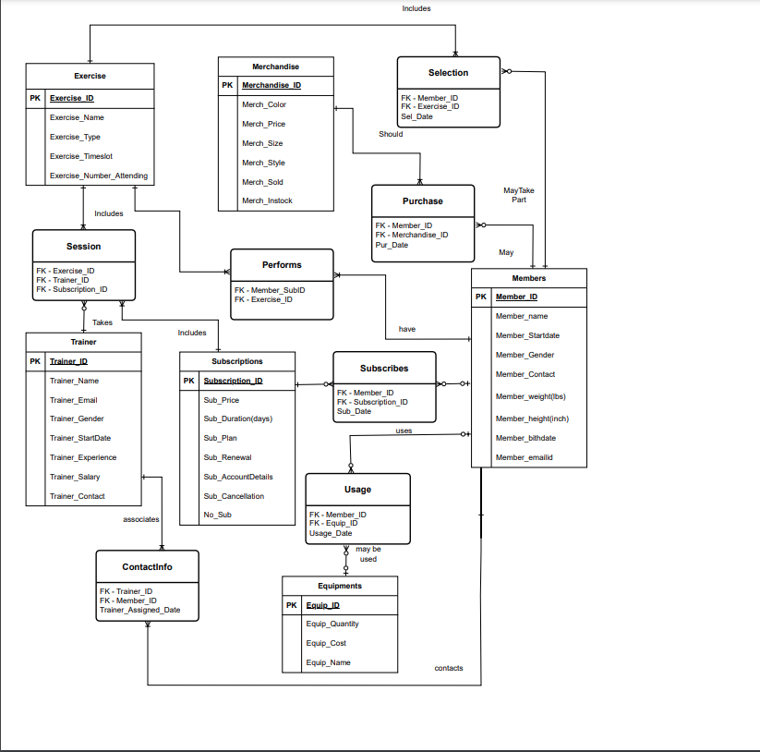
Entity Relationship Diagram

Slide 4
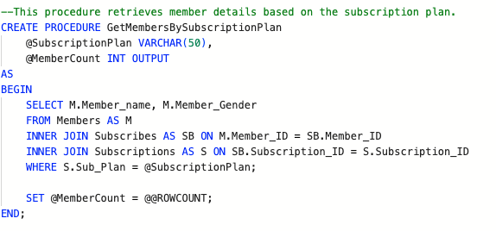
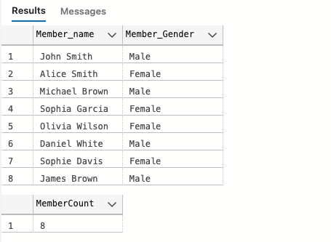
Stored Procedure 1: Retrieve Member Details based on the subscription plan

Slide 5
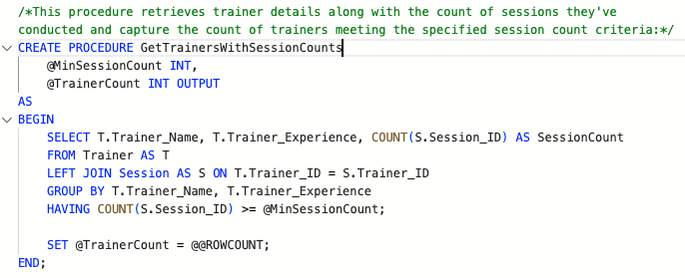
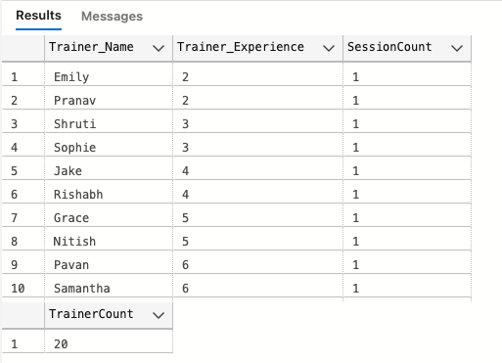
Stored Procedure 2: Retrieve the trainer details along with the count of sessions

Slide 6
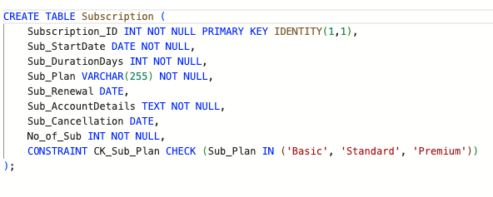
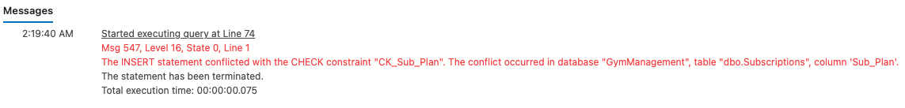
Constraint to not allow different values other than those mentioned for Sub_Plan

Slide 7
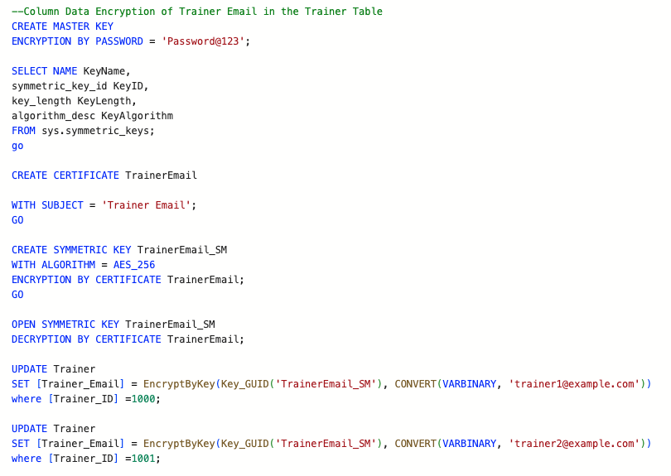
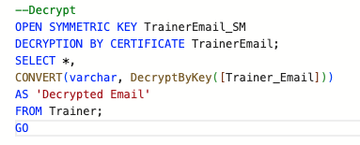
Column Data Encryption
Encryption
Decryption

Slide 8
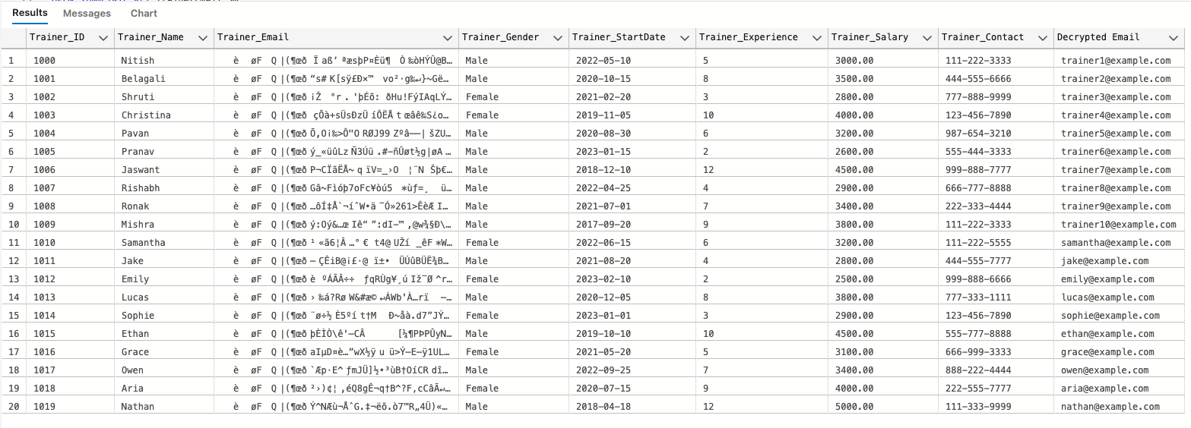
Encryption and Decryption Output

Slide 9
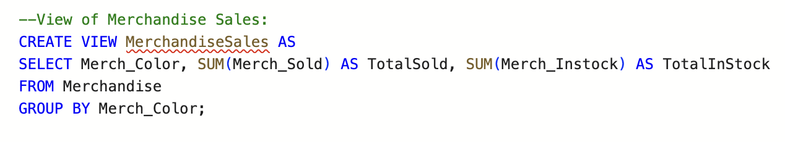
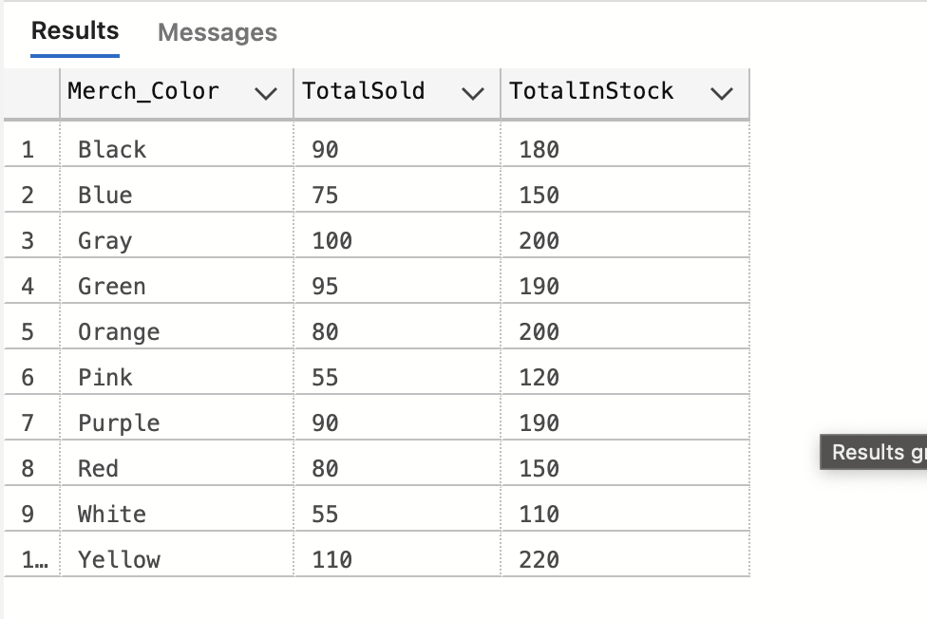
View 1: Showcasing the total number of items in stock for each unique color of merchandise

Slide 10
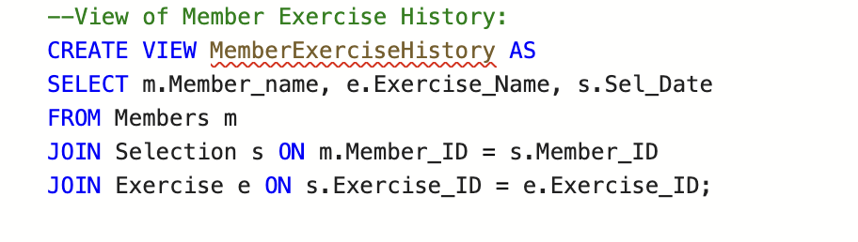
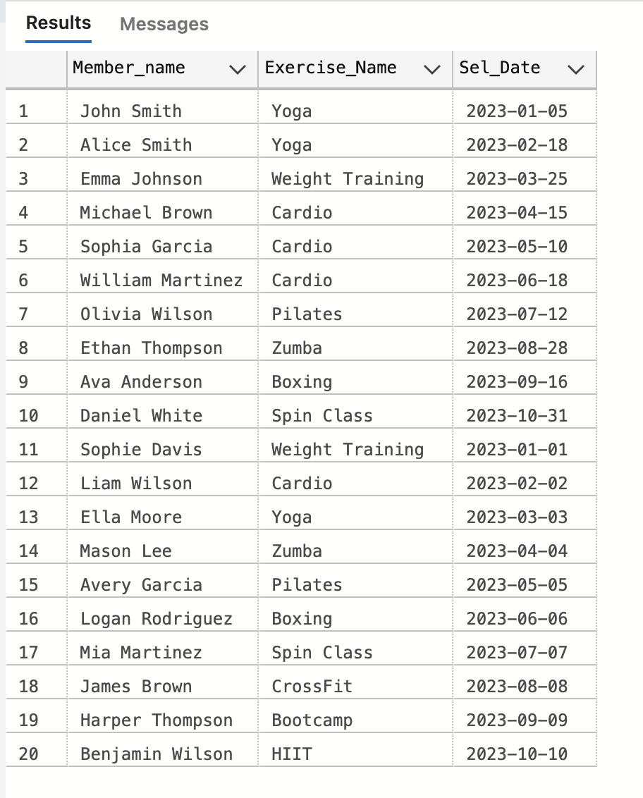
View 2: History of exercises selected by members and the exercises they attended and the date chosen

Slide 11
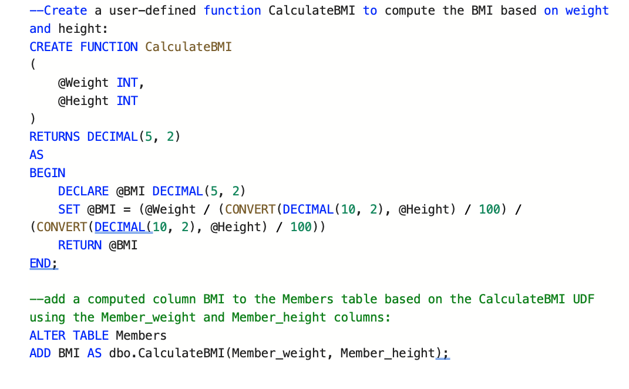
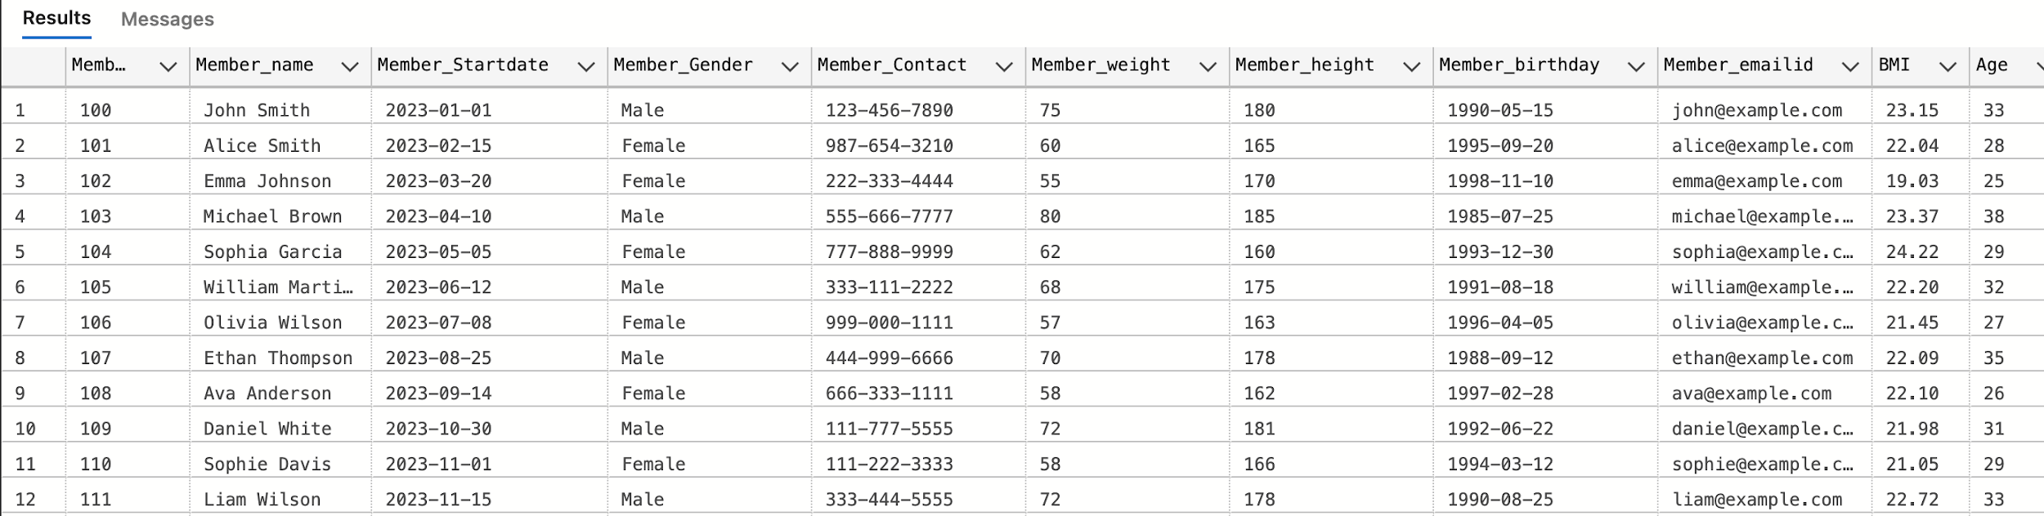
Function 1:Calculate BMI and add a computed column BMI to Members using UDF

Slide 12
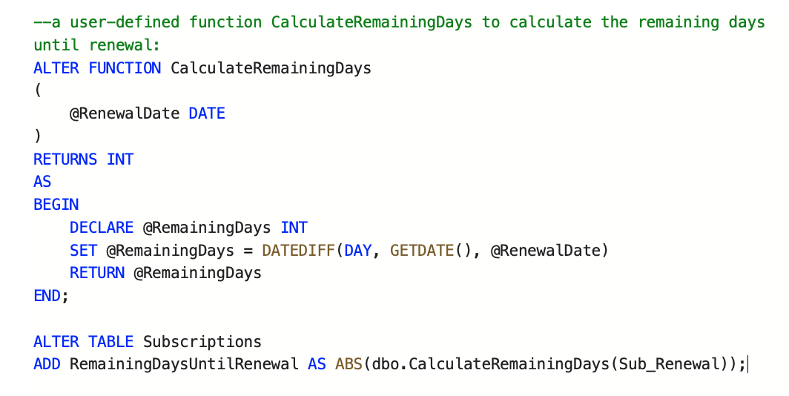
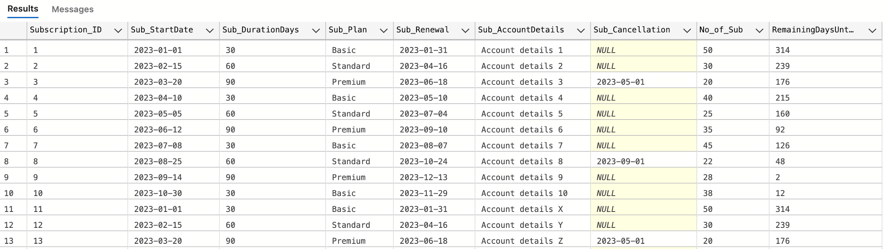
Function 2:Calculate Remaining days until renewal & add a computed column to Subscriptions using UDF

Slide 13
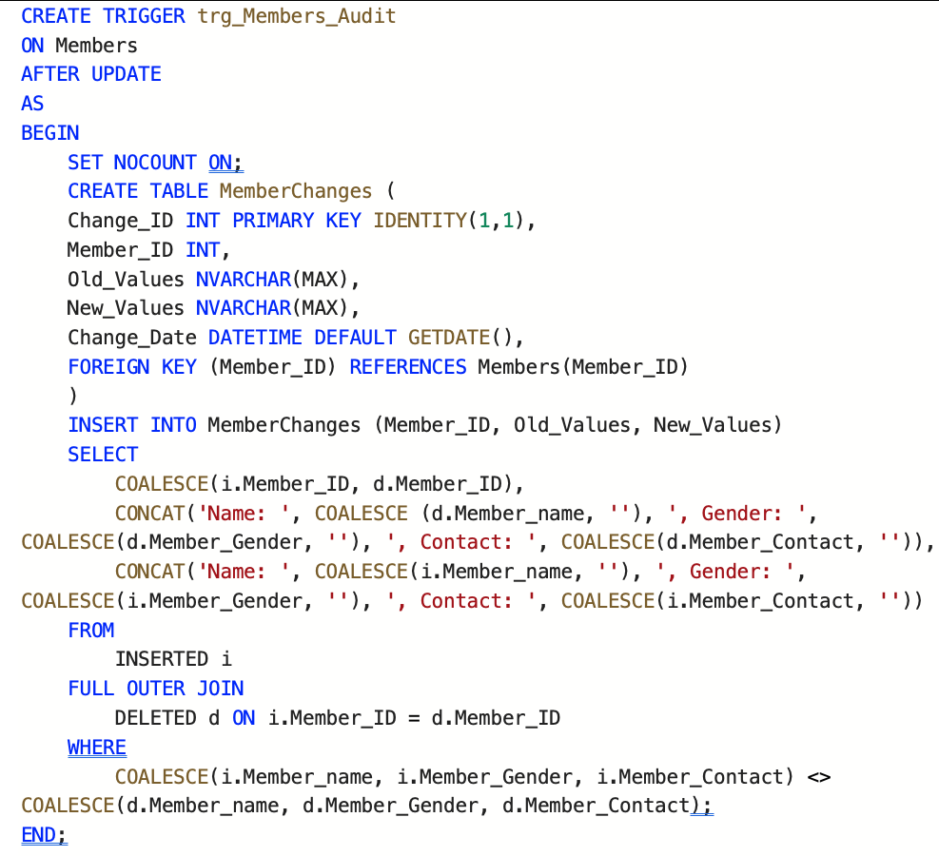
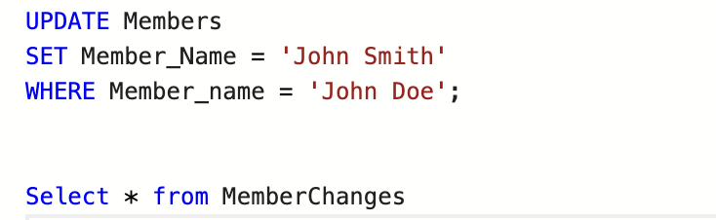
Trigger 1: To check if there is an Update on the Member table and audit the changes into a new table

Slide 14
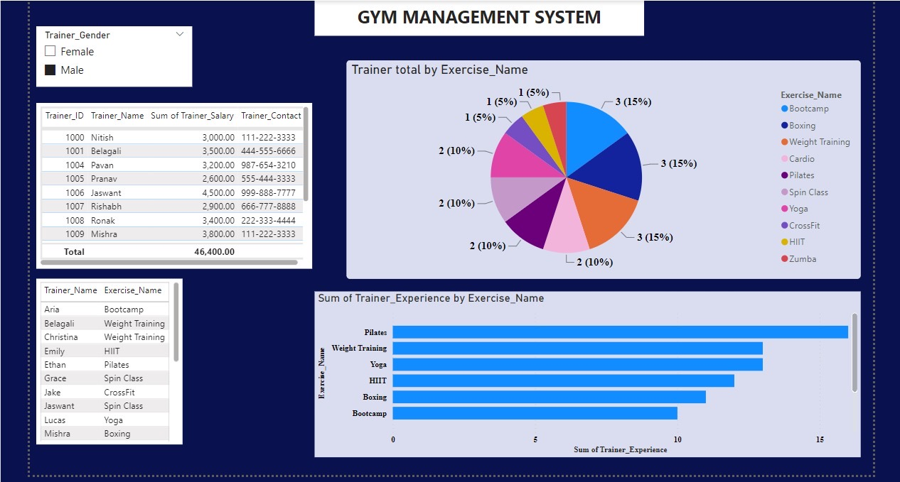
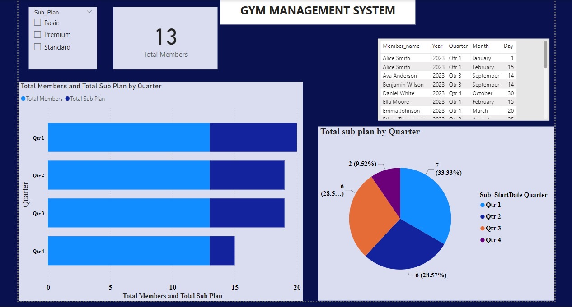
Visualization

Slide 15
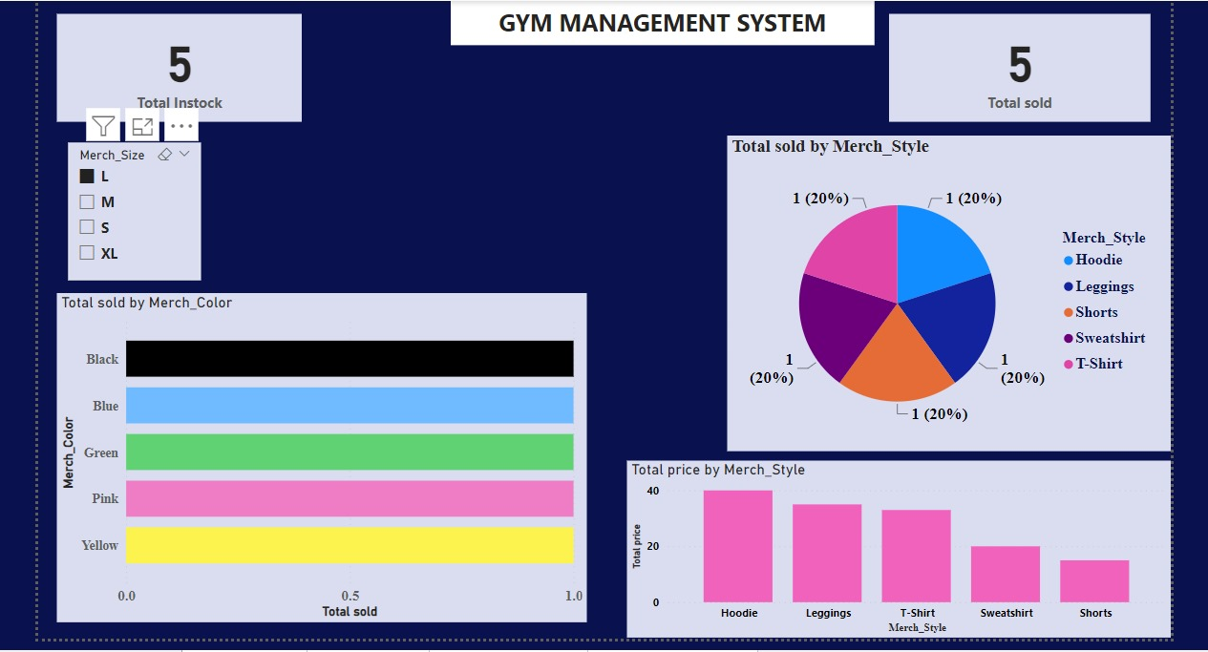
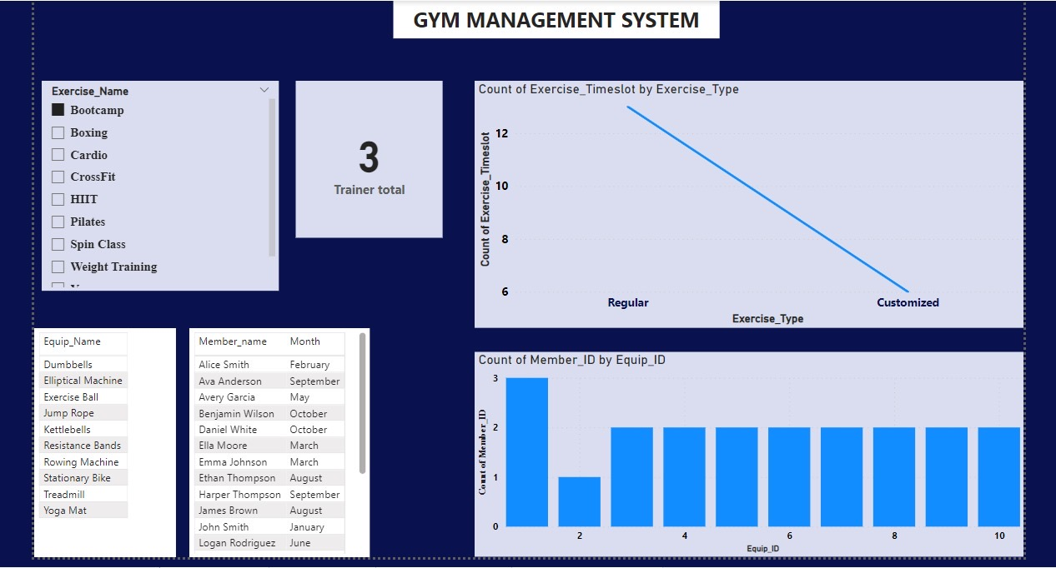
Visualization

Slide 16
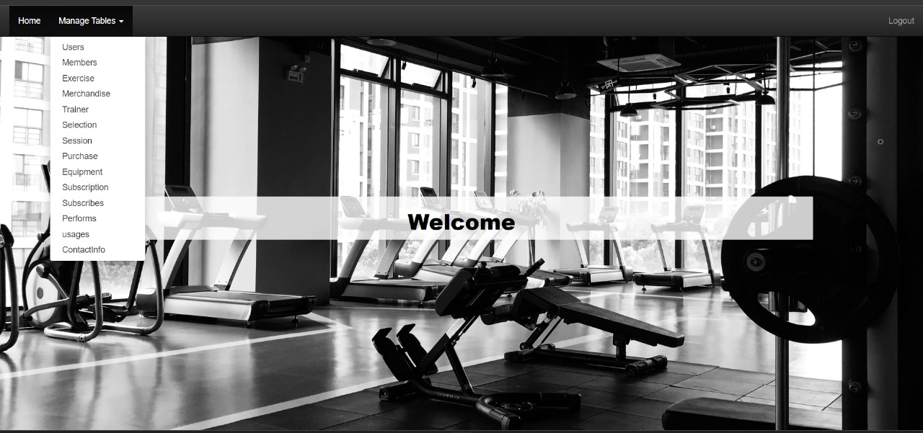
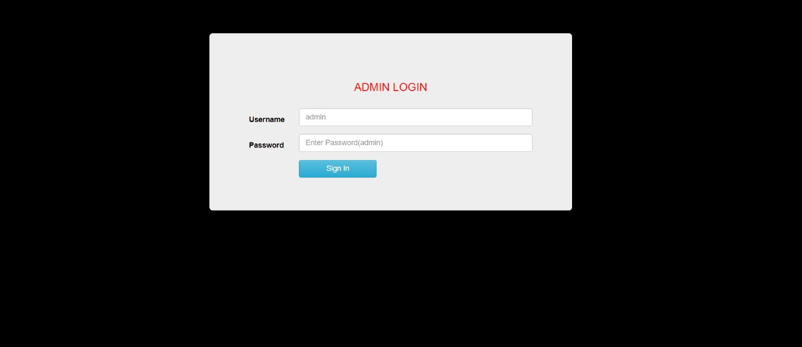
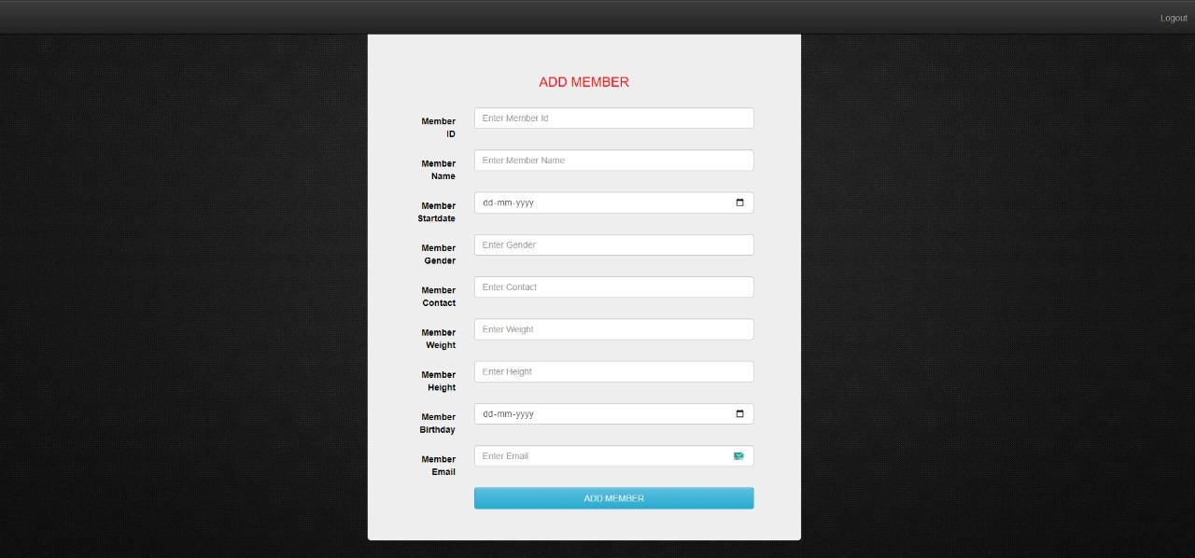
GUI
Login page
Adding a Member

Slide 17
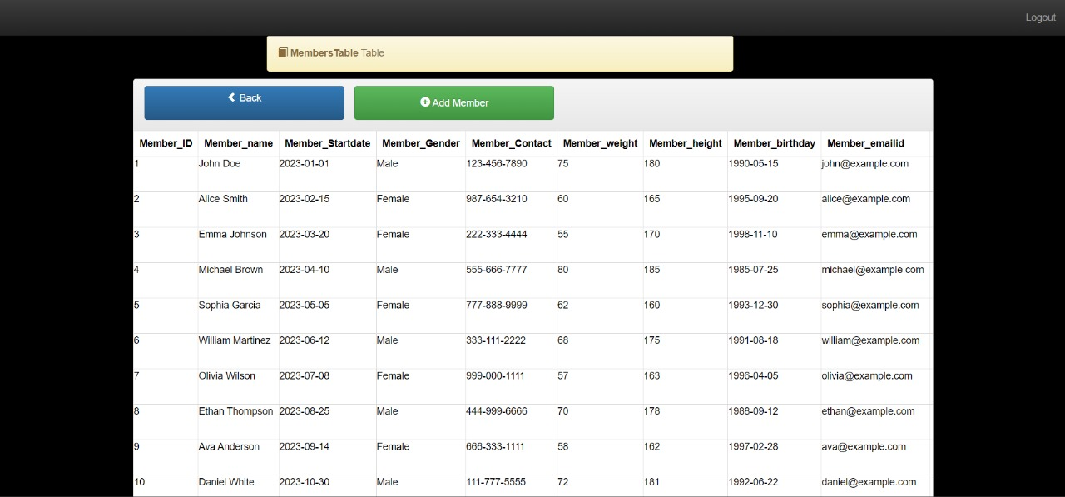
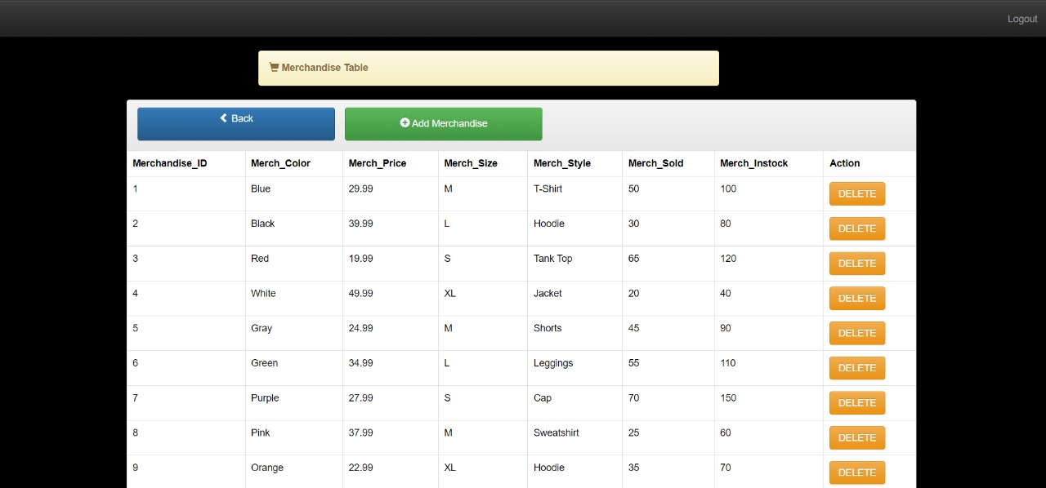
GUI
Delete a Member
Add a Member

Slide 18
Thank you!
Happy Lifting!!

